Slide 1
Need CE credit for this
session?
Please don’t forget to sign in
order to have your
attendance tracked

Slide 2
Disclosures (support):
Relevant Financial Relationships:
employed in Private Practice
Clinical Practice Advisor in the School of Psychology, Victoria University of Wellington
Receive royalties from Hachette and New Harbinger publications for a book written on a topic similar to the subject of this presentation

Slide 3
Living with Stuff that Sucks: Acceptance and Commitment Therapy with Young People Ben Sedley ben@actwellington.co.nz
Notes:
I’m Ben Sedley, a clin psych from Wellington NZ
And author of Stuff that Sucks, its only one book with two different covers
Today we’re going to have an introduction to some of the metaphor exercises I use when working with young people, as well as expanding on a few ideas that can be helpful to keep in mind when doing this work. It is experiential, so I invite you to actively participate in the exercises and the discussion.
It is an introductory level workshop, please ask questions as we go and also feel free to email me questions via my email address or facebook page

Slide 4
Notes:
If you learn one thing this workshop, its this

Slide 5
Notes:
Exercise: And of course, we always start with our breath, and today we’re going to use a perspective taking exercise.
deep breath, connect with what it felt like to be eight to ten, what was happening in your life? What were your worries? What mattered to you? What does it feel like now observing you then?
Now shift your attention to what it felt like to be sixteen …
Turn to person next to you, introduce yourself by telling them about how you found that process and then what mattered to you at 16.
Group reflection
That isn’t an exercise with adolescents, it is one we’re using today to help us shift our perspective to being an adolescent
Did anyone else have the experience I had of noticing that at 16 brains can be a mean critical place, I did lots of comparisons with others and my ideal self, lots of worries about if I was fitting into the group I wanted to be part of.

Slide 6
So how come brains are so critical?
Notes:
To answer this we have to think about what brains are trying to do in the first place
Why do we have brains?
To stop us getting eaten by tigers

Slide 7
Notes:
Exercise So let’s imagine you were walking in Seville and you saw a tiger, what would you do? (stop thinking about other stuff and think only about the tiger)
Discuss in pairs.
What ideas did you come up with?
Note there isn’t even a real tiger, yet you had no trouble doing this exercise.
But what is the biggest danger now?

Slide 8
Notes:
Rejection. Exercise: So in pairs again, how can we avoid rejection?
As group – solutions.
The main solution seems to be to be on the look out for it.
So of course our brains are constantly on the look out for signs that we might not fit in.
Will I screw up? / Everyone saw that last screw up / No one cares about me
No one understands me / What if I’m alone forever?
So our brain is doing its job by thinking about those things? But what happens if we tell others what we’re thinking?
Don’t think like that, think positive…
But what happens if we think about those things? How do we feel?
Feels pretty awful. And what happens if we tell others we feel awful. Sad, Worried, Angry.
Show of hands who has felt better when someone said cheer up

Slide 9
Notes:
So this is where we’re trying to live, particularly as teens.
The world is sad and worrying and frustrating, yet we’re told we’re supposed to feel happy and think positive.
If we think sad thoughts, there’s something wrong with us. So we try not to.

Slide 10
Notes:
Exercise: walk around the room, only catch is every time you have a thought about an apple, stand still until the thought is gone.
Reflection
So we can’t keep thoughts out of our head (or we can but it takes a lot of effort).
Exercise: And thoughts aren’t just thoughts either. From a young age, we learn to create relationships between words and other words – so if I say Black you say…, if I say Twinkle, you say…
, and between words and feelings. I’ll show you what I mean. I’m going to show you some words, and when you see them, notice what you feel, and where you feel it in your body

Slide 11
Sunset

Slide 12
Spider

Slide 13
Cake

Slide 14
Puke

Slide 15
Smile
Notes:
What happened?

Slide 16
Sunset
Notes:
So we don’t just see the word ‘sunset’, we feel it.
This is useful for compassion, poetry, advertising, safety.
And so painful when we think those particularly painful thoughts our brain is programmed to have

Slide 17
Notes:
These thoughts and feelings are huge and painful.
Even for me reading them now, I feel heavy. The one in the middle was something a young man said to me, yelled at me. Within a year he had suicided.
These thoughts aren’t just painful, they can feel life or death. So of course we do all we can to get rid of them.

Slide 18
Notes:
And just like apples, the more we try not to have these thoughts, the more we avoid, argue, distract, abuse, the more we have them. The more we have them, the worse we feel.
Or we can get away from them, but we can’t move towards where we want to go

Slide 19
The more we try not to have these thoughts and feelings, the more we have them, the more we feel them
(and the less time and energy we have to do other things)

Slide 20
Notes:
So if trying to fight thoughts and feelings means we have them more, then what other choices do we have?
Trying to get away from unwanted internal experiences keeps us stuck. So what can we move towards?

Slide 22
Figure out what you care about…
And care about it

Slide 23
Notes:
Remember when your parent used to read to you, you snuggled in close and listened to the story. I’d like to read to you now.
Read Just Right passage.
Reflect in pairs.
Did it feel right because it was connected to something you cared about? The stuff that matters to you?
Have you ever had a time when everything just felt right or meaningful? It may have been a day or an hour or only one second, but for that period of time, none of the sad stuff or scary stuff or stressful stuff mattered, for that moment things just felt true. I can remember one night when I went to a beach and made a bonfire with friends. We stayed the entire night, telling stories, playing guitar and having some deep conversations. Eventually we watched the sun rise over the sea. As I write about it now, it sounds kind of corny and clichéd, but if I let go of those judgements and instead come back to the emotions and sensations, I can remember that at the time the universe just felt right. Think of one of those times for you, then once you have read this paragraph, I’d like you to close your eyes and take yourself back to that moment. Notice what it feels like to be there again. Who are you with? What are you doing? What emotions do you feel? Where do you feel it in your body? OK, have a go. What was that like? What made that moment so special? Did the moment you chose feel so right because it connected to something that you really value? You may have been with friends or family or animals or nature or in a creative zone, but I’m guessing that there was a powerful connection for you. (Stuff that Sucks, P. 43)

Slide 24
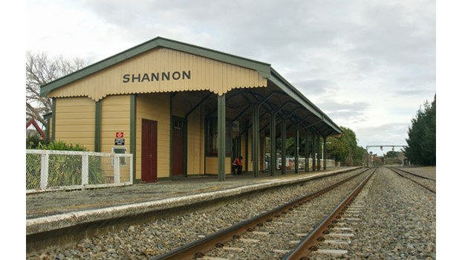
Notes:
Imagine if you met someone sitting at a train station who told everyone how great it is to go West. ‘West is the way of the future,’ he says, ‘we should all keep moving in that direction.’ A year later you pass the same station and the same guy is there, in the exact same spot, still telling everyone they should go West. ‘You need to move West to achieve a meaningful life,’ he proclaims, ‘it is the path to happiness and satisfaction.’ A year later you pass the same station and the guy is still there. Right there. He hasn’t moved one inch in a westerly direction. This time you stop and ask him why he is such a big fan of going West, and he tells you about all the things he has read about the direction West, recommends some useful websites, and even shows you some pictures he has cut out of pamphlets, depicting things you will see if you go West. You ask him what is the best thing he has ever seen while travelling West, and he shakes his head. ‘I’ve never been any more West than here, too many bumps along the way. I’m waiting for them to fix up the track so it will be a smoother journey,’ he tells you. ‘But,’ he adds proudly, ‘I haven’t moved even one inch East in the past few years.’
How seriously would you take that man’s advice to go West? If West is the way to go, maybe it’s worth travelling over some bumps to make progress in that direction? Values are like compass directions. They’re meaningless unless you move. Saying that you really like going West doesn’t mean a whole lot if you don’t take at least a small step in that direction. That doesn’t mean it’s always going to be easy to move West or that you can move miles in that direction every day. Some days it feels like there are things pulling you in every direction or stopping you from moving at all. The blocks might be thoughts, feelings, memories, physiological sensations or other people and their rules. But it’s still worthwhile to move in the directions you care about even if sometimes you are only able to take tiny steps. (Stuff that Sucks, p 50)

Slide 25
Notes:
So if you were going to take one tiny step towards things that you cared about, what would it be?
What is something you can do today that you hadn’t already been planning to do that will enable you at the end of the day to say, I’m not quite sure where I’m heading, and I’m not quite sure exactly what I care about, but I’m one tiny step closer to being the kind of person I want to be or living the kind of life I want to live?
Write that down on a piece of paper.
Look at it, what comes up? what will get in the way?
If 10 was that thing will definitely happen, and 0 was no way, what number is it?
What could you do to raise that number a bit?

Slide 26
Notes:
In order to take these steps we need to find space inside us for thoughts and feelings that are painful, and to know where we are right now.

Slide 27
Notes:
In order to take these steps we need to find space inside us for thoughts and feelings that are painful, and to know where we are right now.
We do this by breathing, using our 5 senses, and noticing that we are having thoughts and feelings rather than being in the middle of our thoughts and feelings – we demonstrated many of these ideas in the initial exercise – breathing, noticing what it felt like to be noticing, noticing the thoughts and the feelings. The Sunset exercise also briefly introduced the idea of defusion

Slide 28
What is this person avoiding?
What are the costs?
Notes:
And so as clinicians, our overall questions are:

Slide 29
Learning from experience
rather than
Learning from an expert
Notes:
We don’t tell clients the answers, we encourage them to observe their experience in the therapy room whilst trying exercises, as well at other times in their lives and then deciding what works for them

Slide 30
SU
SD
SC

Slide 31
Shut Up
Slow Down
Stay Curious

Slide 32
Learning from metaphor
rather than
Learning from words
Notes:
We use metaphor as much as possible.
metaphor is an essential tool in therapy, it allows clients to increase their awareness of things that may not have been there before without requiring lectures or shaming.

Slide 33
A metaphor should:
Target the appropriate aspect
The dominant feature of the metaphor needs to fit the clinical target
The metaphor needs to relate clearly to the behaviour / mechanism that needs to change
Fit the client’s background
Validating the pain the client is experiencing
(Mastering the Clinical Conversation by Matthieu Villatte, Jennifer Villatte and Steven Hayes, 2015)

Slide 34
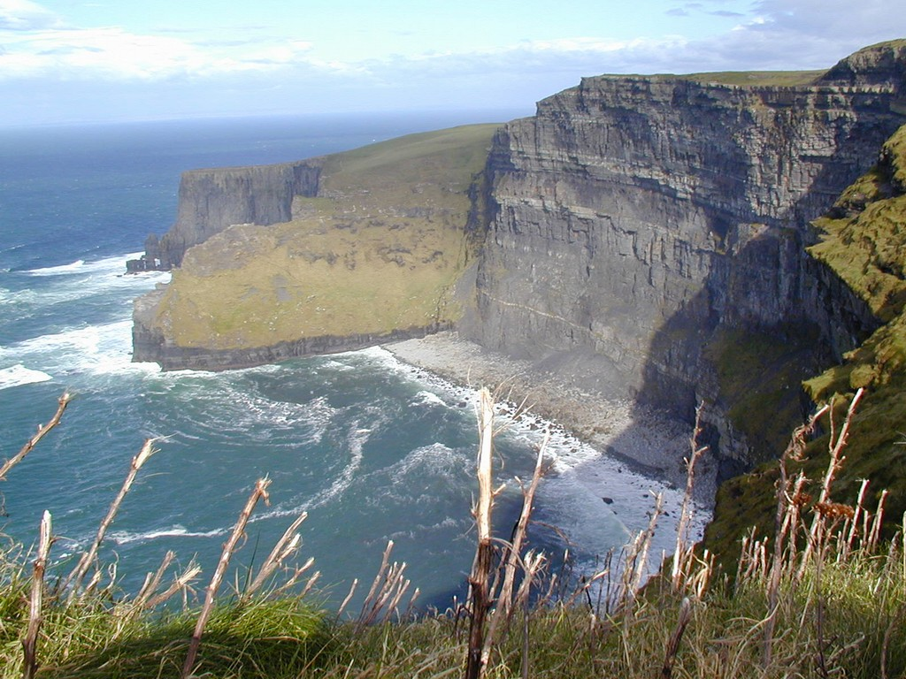
Notes:
For example, a client talked about her anxiety being like she’s falling off a big ledge some days, whereas other days she is able to hold onto the railing and not fall.
We stood up and acted this out – describe or if time, actually do this.
Down the hole are thoughts and feelings (social anxiety, friends will reject me), write these down
Holding onto railing, looking at them all – holding on tightly
Meanwhile where are the things that matter – write these down
How do we take a breath, turn and face them and then walk towards them?

Slide 35
Notes:
Come back to your piece of paper. How can you keep this step in mind for the rest of today or until you’ve done it?

Slide 36
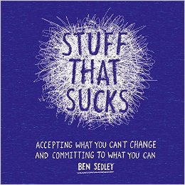
Stuff that Sucks
www.facebook.com/stuff.ts
www.bensedley.com

Slide 37
Need CE credit for this
session?
Please don’t forget to sign in
order to have your
attendance tracked

